Slide 1




“ANOMALY DETECTION IN VIDEO SURVILLENCE ”
DEPARTMENT OF COMPUTER SCIENCE AND ENGINEERING
20CSE84A- PROJECT PHASE II
Sowrabha A 1 1NH20CS214
Lavanya N 2 1NH21CS405
Sowmya M L 3 1NH21CS418
Ms. M Thanga Shuba Devi
Assistant Professor
Dept of CSE
Dr M. Dhanalakshmi
Professor
Dept of CSE
DEPT OF CSE, NEW HORIZON COLLEGE OF ENGINEERING

Slide 2
TABLE OF CONTENTS
01
02
03
04
05
06
Algorithm / Flow Chart
Introduction
07
Results & Discussion
Detailed Analysis of Literature Review
08
Advantages
Problem statement
09
Proposed System
Conclusion & Future
Scope
10
References
Hardware & Software Specification

Slide 3


01
Introduction

Slide 4
Introduction
Real-time video anomaly detection refers to the continuous analysis of video streams to identify abnormal events or behaviors as they occur.
Unlike traditional surveillance methods, which rely on periodic or manual monitoring, real-time anomaly detection offers proactive threat identification and intervention.
Automated surveillance systems leverage advanced technologies to augment human capabilities and mitigate the limitations of manual monitoring.
By automating the process of threat detection and response, these systems enable organizations to address security challenges with greater efficiency and accuracy.

Slide 5
Introduction
The Real-Time Video Anomaly Detection System aims to revolutionize security monitoring by providing instantaneous detection and alerting capabilities.
Computer vision serves as the foundational technology behind the system, enabling the automatic extraction, analysis, and interpretation of visual information from video data.
Through deep learning-based object detection algorithms, the system can accurately recognize and classify objects of interest within the video frames.

Slide 6
02
Detailed Analysis of Literature Review

Slide 7
Sl. No | Title of the Journal | Authors | Publisher | Summary | Drawbacks
[1] | Anomaly Detection in Videos for Video Surveillance | Ruben J Franklin; Mohana; Vidyashree Dabbago | IEEE Transactions | The paper focuses on enhancing security through computer vision's anomaly detection in crowded or isolated areas. Utilizing a three-layered approach, the method achieves a 98.5% accuracy in real-time anomaly detection in both images and videos, showcasing its effectiveness for heightened security measures. | drawbacks include sensitivity to environmental conditions and potential false positives or negatives in anomaly detection, impacting system reliability. Additionally, computational complexity may pose challenges for real-time implementation.

Slide 8
Sl. No | Title of the Journal | Authors | Publisher | Summary | Drawbacks
[2] | Anomaly Detection Methods in Surveillance Videos: A Survey | Lokesh Borawar; Ravinder Kaur | IEEE Transactions | The surge in surveillance data necessitates automated anomaly detection for smart cities and public safety. This survey highlights the growing importance of utilizing deep learning methods, such as GAN, fine-tuned approaches, and keyframes extraction with shallow networks, to detect and recognize unusual behaviors in surveillance footage. | The reliance on automated anomaly detection in surveillance systems, while essential, may introduce challenges related to false positives or misinterpretation of unusual behaviors, impacting the overall accuracy and effectiveness of crime detection. Additionally, the increasing dependence on deep learning methods raises concerns about the potential vulnerability of these systems to adversarial attacks and the need for continuous updates to adapt to evolving security threats.

Slide 9
Sl. No | Title of the Journal | Authors | Publisher | Summary | Drawbacks
[3] | Deep Video Anomaly Detection: Opportunities and Challenges | Jing Ren; Feng Xia; Yemeng Liu; Ivan Lee | IEEE Transactions | The paper underscores the significance of video anomaly detection for ensuring safety in public spaces, leveraging the capabilities of deep learning. While acknowledging the advantages, it highlights the challenges in designing intelligent systems for diverse application scenarios and proposes future research directions to enhance the effectiveness of deep learning-based video anomaly detection methods. | The challenge lies in the diversity of anomaly types across different application scenarios, making it non-trivial to create universally intelligent video anomaly detection systems. Additionally, the reliance on deep learning models introduces potential complexities and resource-intensive requirements, limiting their widespread applicability in certain contexts.

Slide 10
Sl. No | Title of the Journal | Authors | Publisher | Summary | Drawbacks
[4] | A Survey on Video Anomaly Detection | Rajesh Kumar Yadav; Rajiv Kumar | IEEE Transactions | The paper underscores the significance of video anomaly detection for ensuring safety in public spaces, leveraging the capabilities of deep learning. While acknowledging the advantages, it highlights the challenges in designing intelligent systems for diverse application scenarios and proposes future research directions to enhance the effectiveness of deep learning-based video anomaly detection methods. | The challenge lies in the diversity of anomaly types across different application scenarios, making it non-trivial to create universally intelligent video anomaly detection systems. Additionally, the reliance on deep learning models introduces potential complexities and resource-intensive requirements, limiting their widespread applicability in certain contexts.

Slide 11
Sl. No | Title of the Journal | Authors | Publisher | Summary | Drawbacks
[5] | Anomaly Detection using Machine Learning Techniques | Sonali B. Wankhede | IEEE Transactions | Machine learning algorithms, particularly supervised techniques, leverage past experiences to enable systems to learn and exhibit behaviors observed in real data, aiding in the analysis and detection of abnormal instances in networks. The focus of this paper is on employing supervised learning for detecting network anomalies, with applications in fraud detection and machine monitoring. | The reliance on past data for machine learning algorithms may lead to limited adaptability to evolving and novel network threats not encountered in historical datasets. Additionally, supervised learning approaches may face challenges in accurately detecting anomalies if the training data does not comprehensively represent the diversity of potential network abnormalities.

Slide 12
Sl. No | Title of the Journal | Authors | Publisher | Summary | Drawbacks
[6] | Machine Learning for Anomaly Detection: A Systematic Review | Ali Bou Nassif; Manar Abu Talib; Qassim Nasir; Fatima Mohamad Dakalbab | IEEE Transactions | This research paper conducts a Systematic Literature Review on Machine Learning (ML) models for anomaly detection, spanning 2000-2020, identifying 290 articles. The review outlines 43 applications, 29 ML models, and 22 datasets used, emphasizing the prominence of unsupervised anomaly detection and offering recommendations for researchers in this promising field. | The study's limitation lies in the potential bias and incompleteness of the literature review, given the vast and evolving landscape of machine learning applications for anomaly detection. Additionally, the research may not fully capture the latest advancements or emerging trends in this rapidly evolving field, as the data collection span is limited to the years 2000-2020.

Slide 13
Sl. No | Title of the Journal | Authors | Publisher | Summary | Drawbacks
[7] | A Comprehensive Survey of Machine Learning Methods for Surveillance Videos Anomaly Detection | Nomica Choudhry; Jemal Abawajy; Shamsul Huda; Imran Rao | IEEE Transactions | This paper offers a comprehensive survey of cutting-edge machine learning methods employed in Video Surveillance Systems (VSSs), addressing drawbacks in existing surveys by providing in-depth analysis, critical evaluation of algorithms, and tailored classifications for anomaly detection. The study aims to guide future developments in VSS learning techniques, serving as a valuable resource for researchers and practitioners in the field. | While comprehensive, this survey on learning methods in Video Surveillance Systems may face limitations in maintaining real-time relevance as the field evolves rapidly. Additionally, subjective assessments of algorithm strengths and weaknesses could be influenced by the specific datasets and scenarios considered, impacting the survey's generalizability.

Slide 14
03
Problem statement

Slide 15
Problem statement
Critical task in video surveillance - Detecting anomalous events such as traffic accidents, crimes and other illegal activities.
Generally, anomalous events rarely occur as compared to normal activities. So, to alleviate the waste of labour and time, developing intelligent computer vision algorithms for automatic video anomaly detection is a pressing need.
Our project aims at making the detection of anomalous events in private properties like residences easier using YOLO algorithm.
Our system involves a surveillance camera set up in residences like independent houses and apartments, that captures video and detects any anomalous activities in them.
It detects anomalies like a fire, or weapons like a gun or a rifle in the surveillance videos.

Slide 16
04
Proposed System

Slide 17
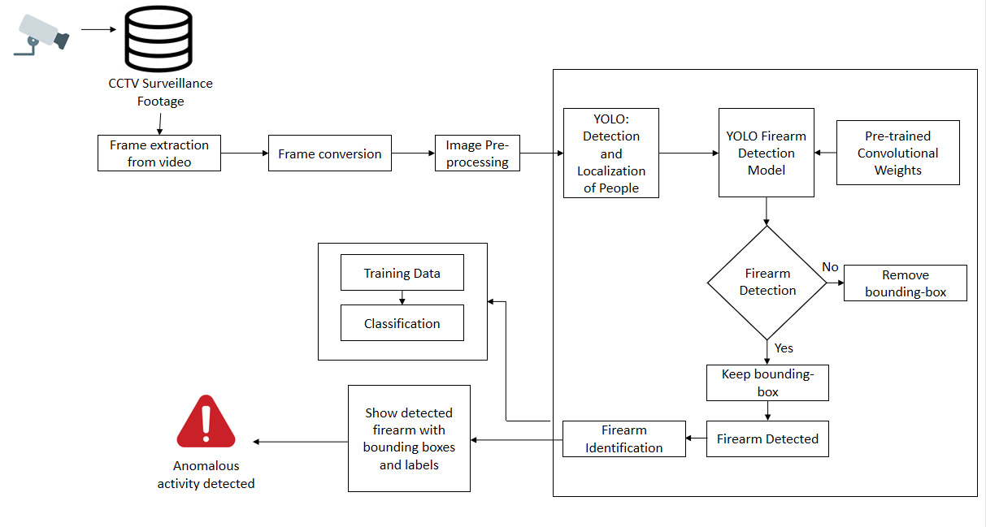

Slide 18
Proposed System
Object Detection Capability:
→The system is currently designed to detect specific objects within video frames, focusing primarily on identifying fires and rifles.
→Object detection algorithms have been trained to recognize the visual characteristics of fires and rifles, allowing the system to accurately identify these objects within the monitored environment.
Anomaly Detection:
→ In addition to object detection, the system will incorporate algorithms for anomaly detection to identify deviations from normal behavior patterns.
→Anomaly detection algorithms will analyze the detected objects and their interactions within the video frames to identify suspicious or unusual activities.

Slide 19
Proposed System
Alert Mechanisms:
→Alert mechanisms will include email notifications and sound alerts, ensuring that security personnel can respond promptly to potential threats.

Slide 20
05
Hardware & Software Specification

Slide 21
Hardware Requirements
1. Computing Hardware:
- Multi-core CPU (e.g., Intel Core i5 or AMD Ryzen 5).
- Optional: Dedicated GPU (NVIDIA GeForce or AMD Radeon) for accelerated processing.
2. Memory (RAM):
- Minimum: 8GB RAM.
- Recommended: 16GB or more.
3. Storage:
- Solid State Drive (SSD) or Hard Disk Drive (HDD) with minimum 500GB capacity.
4. Network Infrastructure:
- Stable internet connection or local network connectivity.
- Wired Ethernet connection recommended.

Slide 22
Software Requirements
→Python
3.X and above
→OpenCV
→NumPy
→pygame
2.5.2
→YOLO

Slide 23
06
Algorithm / Flow Chart

Slide 24
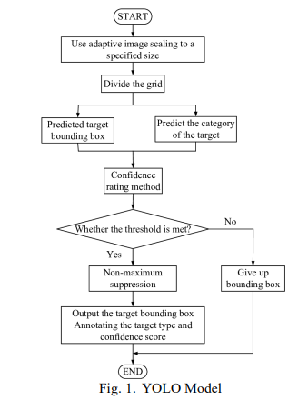

Slide 25
07
Results & Discussion

Slide 26
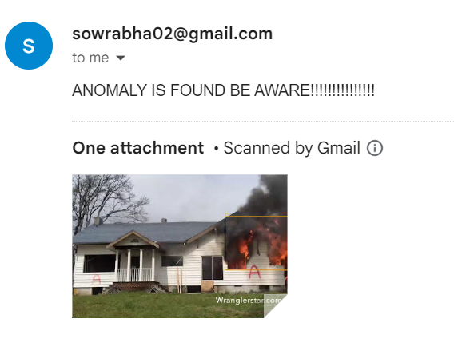

Slide 27
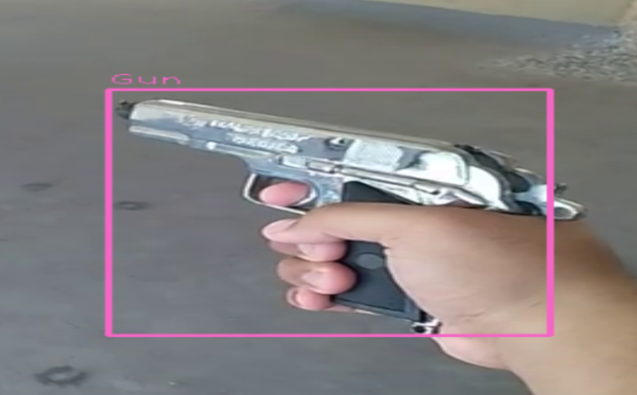

Slide 28
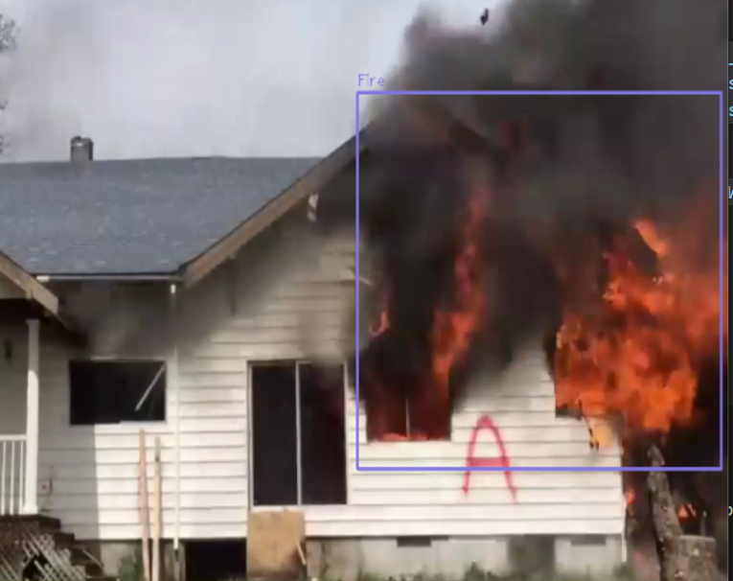

Slide 29
Results
Detection of anomalies such as fire, gun, and rifle in video streams.
Prompt email notifications and sound alerts upon anomaly detection.
Integration with YOLOv3 object detection model for accurate detection of objects.
Efficient processing of video frames for real-time monitoring and analysis.
Demonstrated potential for enhancing security surveillance and threat detection capabilities.

Slide 30
Advantages
08

Slide 31
Advantages
Proactive Threat Detection: The system enables proactive detection of security threats by continuously monitoring video streams for anomalies in real-time.
Rapid Response: Prompt email notifications and sound alerts facilitate rapid response from security personnel upon detecting anomalies, minimizing response times and mitigating potential risks.
Enhanced Security Surveillance: By leveraging computer vision techniques and object detection algorithms, the system enhances security surveillance capabilities across various environments and sectors.

Slide 32
Advantages
Automation and Efficiency: Automated surveillance reduces the reliance on manual monitoring, freeing up resources and personnel for other critical tasks and improving operational efficiency.
Scalability: The system is scalable and capable of handling large volumes of video data from multiple surveillance cameras simultaneously, ensuring comprehensive coverage of the monitored area.
Customizable Detection Capabilities: Object detection algorithms can be customized and tailored to detect specific objects or behaviors of interest based on security requirements and operational needs.

Slide 33
Advantages
Real-Time Monitoring: The system provides real-time monitoring and analysis of video streams, enabling immediate identification and response to security threats as they occur.
Versatility: The system's customizable nature allows for adaptation to various environments and use cases, making it suitable for deployment in diverse settings such as airports, train stations, public venues, and sensitive facilities.
Improved Safety and Security: Overall, the Real-Time Video Anomaly Detection System contributes to improved safety and security by proactively identifying and addressing potential security threats, safeguarding lives, assets, and infrastructure.

Slide 34
09
Conclusion & Future Scope

Slide 35
Conclusion
The Real-Time Video Anomaly Detection System represents a significant advancement in security surveillance and threat detection capabilities.
By leveraging computer vision techniques and automated surveillance, the system enhances safety and security across various environments.
Proactive threat detection, rapid response mechanisms, and scalability make the system invaluable for mitigating security risks and safeguarding lives and assets.

Slide 36
Future Scope
Expansion of Object Detection Capabilities: There is potential for expanding the range of detectable anomalies and objects, addressing emerging security threats and operational requirements.
Collaboration with Law Enforcement Agencies: Collaboration with law enforcement agencies for coordinated response to security incidents can further enhance the system's effectiveness.
Deployment of Mobile Surveillance Units: Deployment of drones or mobile surveillance units equipped with the system can enable dynamic monitoring and surveillance in remote or high-risk areas.
Continuous Research and Development: Continuous research and development efforts are essential for staying abreast of evolving security challenges and technological advancements, ensuring the system remains at the forefront of security innovation.

Slide 37
10
References

Slide 38
References
Abirami Sreerenganathan, Vyshali Rao K P and M Dhanalakshmi , “Assistive Application for the Visually Impaired using Machine Learning and Image Processing”, 14th ICCCNT IEEE Conference July 6-8, 2023 IIT-Delhi, Delhi, India
A. P. Jana, A. Biswas and Mohana, "YOLO based Detection and Classification of Objects in video records," 2022 3rd IEEE Conference on Recent Trends in Electronics, Information & Communication Technology (RTEICT), Bangalore, India, 2022, pp. 2448-2452, doi: 10.1109/RTEICT42901.2018.9012375
Sarda, S. Dixit and A. Bhan, "Object Detection for Autonomous Driving using YOLO [You Only Look Once] algorithm," 2021 Third Conference on ICICV, Tirunelveli, India, 2021, pp. 1370-1374, doi:10.1109/ICICV50876.2021.9388577
R. Huang, J. Pedoeem and C. Chen, "YOLOLITE: A Real- Time Object Detection Algorithm Optimized for Non-GPU Computers," 2022 IEEE International Conference on Big Data (Big Data), Seattle, WA, USA, 2022, pp. 2503-2510, doi:10.1109/BigData.2018.8621865.

Slide 39
11
Conference

Slide 40


Slide 41


Slide 42

THANK YOU

